Slide 1


Predictive Movement Modeling Using HMMs and DBNs By Akash Rana
Notes:
Hello everyone.
My name is Akash Rana, and today I’ll be presenting my project titled Predictive Movement Modeling Using HMMs and DBNs.
This project focuses on understanding and forecasting user behavior in smart home environments using probabilistic models—specifically, Hidden Markov Models and Dynamic Bayesian Networks.”

Slide 2

Why This Project?
🔍 Motivation
I’m working toward a comprehensive smart home automation system.
To enhance comfort, energy efficiency, and personal care, we need to anticipate user behavior.
Imagine:
Locking doors when the user leaves for work.
Brewing coffee when the user is likely to wake up.
Adjusting lighting or AC when the user moves from rest to work mode.
Notes:
“The idea behind this project stems from my long-term vision of building a fully automated smart home system—one that doesn’t rely on manual input but instead anticipates the user’s needs and reacts automatically.
This project is a step in that direction.
The core objective is to predict the user’s next move and automate actions accordingly.
To make such intelligent decisions, we need a model that can understand and predict human behavior—and that’s what this project aims to do.”

Slide 3

The Core Idea
Human behavior is sequential and context-aware.
If we can predict the user’s next state (e.g., sleepy, hungry, active), we can automate meaningful actions.
This requires a model that can:
Learn from historical sensor observations.
Infer hidden internal states (e.g., “user feels sleepy”).
Predict transitions between those states.
Notes:
This is where intention prediction comes in.
We model the user’s experience as a sequence of internal states—like Working, Sleepy, or Hungry—each of which emits observable actions, such as sitting, walking, or lying down.
By learning to infer the user’s current internal state from sensor data, we can then predict the most likely next state. And with that prediction, we unlock the potential for highly adaptive and context-aware smart automation.”

Slide 4

Modeling Approach
We model user states as nodes (e.g., Working, Sleepy, Eating).
Transitions (edges) represent how users move between states.
Observations (e.g., sitting, walking, lying down) are emitted by each state.
Goal: Determine the user's current hidden state and predict the most probable next state
Notes:
“The core challenge in this project is to learn hidden user states and their transition patterns from historical sensor data.
To address this, we need a model that satisfies a few key requirements:
It should represent hidden internal states like the user’s intentions or feelings,
Capture how those states evolve over time,
Learn how observable actions—like walking or sitting—relate to those hidden states,
And importantly, handle uncertainty while working in real time.
This is why I’ve adopted a probabilistic modeling approach—because it aligns naturally with how humans behave: sequentially, contextually, and often unpredictably.”

Slide 5

Why HMM?
Hidden Markov Models (HMMs) are ideal because:
They model hidden states (e.g., intentions).
Learn transition patterns between states.
Associate observable actions with internal states.
Handle sequential, uncertain data effectively.
Notes:
“This brings us to Hidden Markov Models—or HMMs—which provide a natural and mathematically grounded way to model this problem.
In an HMM:
The hidden states capture the user’s internal condition, like being active, idle, or sleepy.
The observations come from sensor-detected behaviors—like movement or location.
Transition probabilities represent how likely a user is to shift from one state to another.
And emission probabilities model how likely a particular observation is, given a specific internal state.
HMMs are particularly well-suited for this domain because they balance interpretability, computational efficiency, and real-time inference.
They work effectively even when the data is sparse but structured—as is often the case in smart home environments.”

Slide 6

HMM Implementation
Observations = (Activity, Location)
e.g., “Cooking in kitchen” → hidden state could be Cooking or Hungry
“Sleeping in bedroom” → hidden state likely Sleeping
HMM was used to infer the hidden user state and predict the next location.
❌ Limitation Observed
Initial results were less accurate in forecasting user behavior.
Reason: (Activity, Location) alone is insufficient to understand user intent or routine.
Missing context like time of day or temperature significantly affects behavior.
Notes:
“In this project, I used HMMs to map observations—such as user activities and locations—to the user’s underlying internal state.
Let me give you a few examples:
If the system observes ‘cooking in the kitchen’, the hidden state could be cooking or possibly hungry.
If it detects ‘sleeping in the bedroom’, the likely hidden state is simply sleeping.
The goal of the HMM here is twofold:
Infer the current hidden user state.
Predict the most probable next location or activity.
However, during testing, I encountered a key limitation.
The model’s predictive accuracy was less than 10%. Why? Because activity and location alone are not enough to fully capture user intent or routine.
Important context—like the time of day or temperature—heavily influences behavior, and these were missing from the initial model.”

Slide 7

Model Enhancement with DBN
Solution: Pass top-3 HMM predictions to a Dynamic Bayesian Network (DBN).
DBN refines predictions using:
Time of Day 🕒
Current Temperature 🌡️
Contextual Quantization
To improve learning and reduce noise, continuous variables were discretized:
This creates a powerful two-stage pipeline:
The HMM captures sequential behavioral transitions,
The DBN applies contextual intelligence to pick the most probable next move.”
(Activity, Location) → HMM → [Top 3 States] + (Time, Temp) → DBN → Final Prediction
Notes:
“Upon further analysis, I found that human decisions are deeply influenced by contextual cues—things like:
Time of day—people tend to eat, sleep, or relax according to circadian rhythms.
Temperature—extreme temperatures often affect whether someone chooses to stay active or at rest.
These factors don’t appear directly in the activity or location data, but they modulate behavior in consistent and meaningful ways. So, incorporating them became essential for improving prediction accuracy.
To address this, I enhanced the model by introducing Dynamic Bayesian Networks, or DBNs.
Here’s how it works:
First, the HMM generates the top-3 most likely user states based on (activity, location) sequences.
Then, these predictions are passed into a DBN.
The DBN incorporates additional quantized contextual variables like time of day and temperature to refine the final prediction.
This creates a powerful two-stage pipeline:
The HMM captures sequential behavioral transitions,
The DBN applies contextual intelligence to pick the most probable next move.”

Slide 8
Dataset Overview
Source: CASAS Smart Home Project – WSU
Real-world smart home datasets from Washington State University.
Multiple datasets merged to form a unified collection of user behavior data.
Rich in sensor-based observations tied to human activities.
Activity | User’s action (e.g., Cooking, Sleeping)
Location | Room/Area (e.g., Kitchen, Bedroom)
Temperature | Ambient temp (quantized: Cold, Moderate, Hot)
Time | Time of day (quantized: Morning, Afternoon, Evening, Night)
Notes:
“To build and evaluate the predictive models, I began by exploring datasets from the CASAS Smart Home Project at Washington State University. CASAS is one of the leading initiatives in smart home research, providing real-world datasets collected from sensor-rich residential environments.
These datasets contain detailed logs of user activities, sensor triggers, and environmental conditions—making them ideal for behavioral modeling.

Slide 9
Dataset Preprocessing
Preprocessing Pipeline
Dataset Merging
Aligned sensor formats across multiple CASAS deployments.
Normalized timestamp formats and resolved missing data.
Feature Engineering
Mapped sensor events → (Activity, Location) tuples.
Extracted time of day and temperature from logs.
Context Quantization
Time → Morning, Afternoon, Evening, Night
Temperature → Cold, Moderate, Hot
Cleaning & Sequencing
Removed noisy sensor readings.
Maintained temporal fidelity in sequences.
Result: A structured dataset suitable for temporal modeling (HMM) and context-aware prediction (DBN).
Notes:
During the early stages, I examined multiple CASAS datasets. However, to create a more comprehensive and generalizable dataset, I partially merged them. This required:
Aligning different sensor formats,
Normalizing timestamp formats,
And resolving inconsistencies across various deployment sites.
After careful preprocessing, I created a unified dataset tailored to this project’s modeling goals.
The final dataset includes four essential features:
Activity – The labeled user action like Cooking, Sleeping, or Eating.
Location – The room or area associated with that action, such as Kitchen or Bedroom.
Temperature – The ambient temperature during the activity.
Time – Either the exact timestamp or a categorized time-of-day label like Morning or Evening.
These contextual variables were key to improving the model’s ability to capture not just actions—but also the intent behind those actions.”

Slide 10
Hidden Markov Model (HMM)
What is an HMM?
A probabilistic model for sequential data.
Assumes there’s a hidden internal state at each time step (e.g., user’s intent or mood).
Each hidden state emits an observable action, like (Cooking in Kitchen) or (Sleeping in Bedroom).
🧠 Why HMM for This Project?
Models temporal dependencies in user behavior.
Separates what is observed (activity, location) from what is inferred (intent).
Can learn from sequences and predict the next most likely user state.
Notes:
“Let’s now take a deeper look at the HMM framework used in this project.
A Hidden Markov Model is a probabilistic model that’s ideal for sequential data—like human behavior over time.
It assumes that:
At any given moment, there’s an internal hidden state—such as the user being active, sleepy, or hungry.
This hidden state emits an observable action, like walking, cooking, or sleeping.
Why is HMM a good fit for this task?
It explicitly models temporal dependencies, which is critical because human behavior naturally follows sequences.
It separates observable data (like sensor activity) from latent intent, allowing us to reason about what the user might be thinking or feeling.
And most importantly, it can learn from historical sequences and predict what’s likely to happen next—even under uncertainty.
This makes HMMs especially effective for smart home settings, where actions aren’t random—they’re often influenced by time, habits, and routines.”

Slide 11

Model Structure
States (S): Hidden states (e.g., Active, Hungry, Sleepy)
Observations (O): Observable events (e.g., Walking in Hallway)
Transition Probabilities (A):
P(S_t \mid S_{t-1})
Emission Probabilities (B):
P(O_t \mid S_t)
Initial State Distribution (π)
Notes:
“This slide explains the internal components of the HMM used in this project.
The model consists of five key elements:
States (S) – These are the hidden user states, such as Active, Hungry, or Sleepy. These represent the user’s internal condition, which we can’t directly observe.
Observations (O) – These are the sensor-detected actions, like ‘Walking in Hallway’ or ‘Sleeping in Bedroom’.
Transition Probabilities (A) – This models the likelihood of moving from one state to another, for example:ex- P(Sleepy → Hungry) or P(Hungry → Active).
Emission Probabilities (B) – This models the likelihood of seeing a certain observation given a hidden state. For example, a ‘Walking’ observation might be more likely when the user is in an Active state.
Initial State Distribution (π) – This gives the starting probabilities of each state when the sequence begins.

Slide 12
Key Algorithms Used
Forward-Backward: Computes likelihood over time.
Baum-Welch: Trains the model using EM algorithm.
Viterbi: Finds the most likely hidden state sequence.
Each box = hidden state
Arrows = transition probabilities
Each state emits an observation
[Sleepy] --(0.7)--> [Hungry] --(0.6)--> [Active]
| | |
'Sleeping' 'Cooking’ 'Walking'
Notes:
To make the model work:
I used the Forward-Backward algorithm to compute the likelihood of sequences,
The Baum-Welch algorithm to train the model via Expectation-Maximization,
And the Viterbi algorithm to find the most probable sequence of hidden states.
The graphical illustration shows how each state emits observations and transitions over time—essentially modeling how the user’s mental or physical state evolves during the day.”

Slide 13
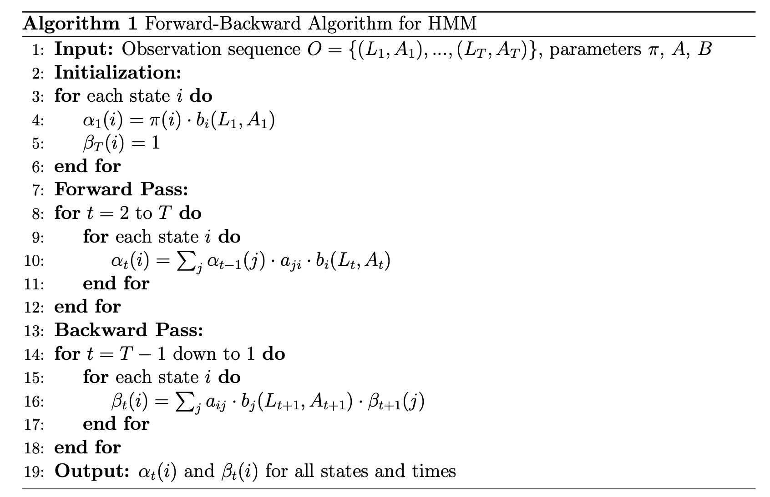
Notes:
The Forward-Backward algorithm is a foundational inference method used in HMMs to compute the likelihood of being in a particular hidden state at a specific time, given the entire observation sequence.
Key Components:
We’re given:
An observation sequence O = \{(L_1, A_1), …, (L_T, A_T)\}, where each observation is a (location, activity) pair.
Model parameters:
\pi: initial state probabilities
A: transition probabilities
B: emission probabilities
⏩ Forward Pass:
The goal here is to calculate \alpha_t(i), which represents the probability of ending up in state i at time t, having seen the first t observations.
Initialization:
For each state, multiply its start probability \pi(i) by the likelihood of emitting the first observation from that state.
Recursion:
At each time step, we sum over all possible transitions into state i, and multiply by the emission probability of the current observation.
⏪ Backward Pass:
The backward pass computes \beta_t(i), the probability of seeing the remaining observations from time t+1 to T, given we’re in state i at time t.
Initialization:
The final time step’s backward probability is set to 1 for all states.
Recursion:
For each earlier time step, we compute how likely it is to transition from state i to each next state j, emit the next observation, and continue the sequence.
🧠 Why It Matters:
Combining \alpha_t(i) and \beta_t(i) gives us the posterior probability of being in state i at time t, which is critical for training (Baum-Welch), decoding (Viterbi), and prediction.

Slide 14
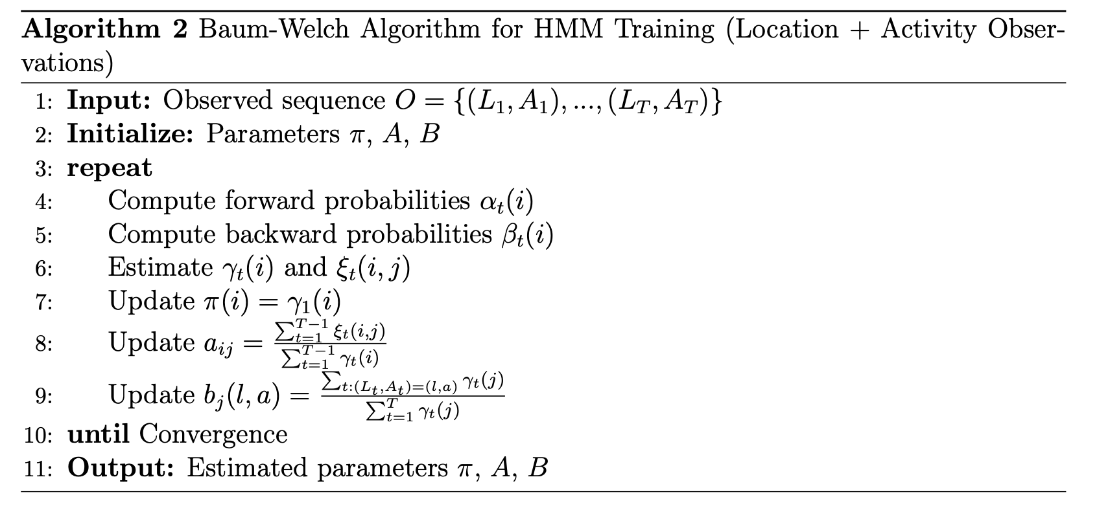
Notes:
The Baum-Welch algorithm is an Expectation-Maximization (EM) approach used to train the parameters of a Hidden Markov Model. It helps us learn the initial state probabilities, state transition probabilities, and emission probabilities directly from observed sequences—here, (Location, Activity) pairs.
🔁 High-Level Process
The training process iteratively refines the model parameters until convergence.
Initialization:
Start with some initial guesses for the model parameters \pi, A, and B.
Expectation Step (E-step):
Compute forward and backward probabilities:
\alpha_t(i): how likely it is to reach state i at time t
\beta_t(i): how likely it is to observe the rest of the sequence given state i at time t
Posterior Estimates:
\gamma_t(i): probability of being in state i at time t
\xi_t(i, j): probability of transitioning from state i to state j at time t
Maximization Step (M-step):
Update:
\pi(i) = \gamma_1(i): new initial state probability
a_{ij}: expected transitions from i to j, normalized over total transitions from i
b_j(l, a): expected frequency of emitting observation (location, activity) from state j
🔚 Convergence:
This process repeats until the parameters stop changing significantly—i.e., the model has learned from the data.
🧠 Why It’s Important:
Baum-Welch is the core training algorithm for our HMM. Without it, we can’t learn from user sequences or make meaningful predictions. It converts raw sensor logs into a structured probabilistic model of behavior.

Slide 15
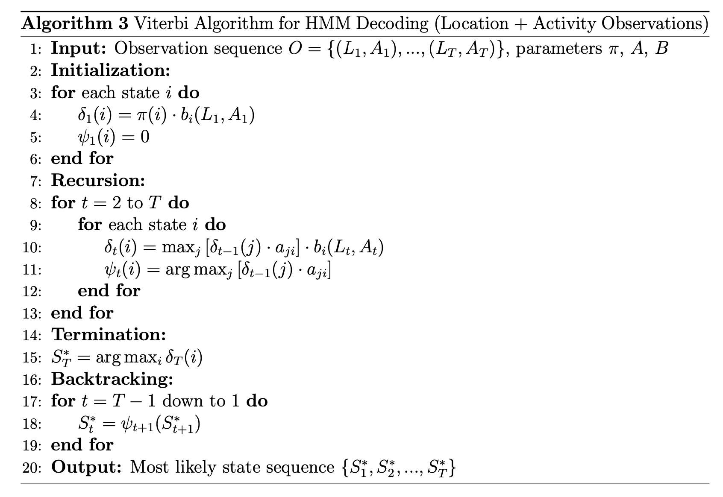
Notes:
The Viterbi algorithm is used in Hidden Markov Models for decoding—the task of determining the most likely sequence of hidden states that could have generated a given observation sequence. In our case, that means inferring the sequence of user intent states that best explains the observed (location, activity) pairs.
🔁 Step-by-Step Breakdown
Input:
We begin with:
An observation sequence O = \{(L_1, A_1), …, (L_T, A_T)\}
HMM parameters \pi, A, and B
Initialization:
For each state i, compute:
\delta_1(i) = \pi(i) \cdot b_i(L_1, A_1)
This gives the probability of starting in state i and emitting the first observation.
Initialize the backpointer \psi_1(i) = 0
Recursion:
For each time step t from 2 to T:
For each state i, compute:
\delta_t(i) = \max_j [\delta_{t-1}(j) \cdot a_{ji}] \cdot b_i(L_t, A_t)
And store the best previous state:
\psi_t(i) = \arg\max_j [\delta_{t-1}(j) \cdot a_{ji}]
Termination:
Identify the state with the maximum probability at the last time step:
S_T^* = \arg\max_i \delta_T(i)
Backtracking:
Starting from S_T^*, use the \psi pointers to trace backward and reconstruct the full path of hidden states.
🎯 Purpose and Importance
Viterbi is essential for making definitive predictions about the most likely state sequence. While the Forward-Backward algorithm gives probabilities across all states, Viterbi gives us a single, most confident path, which is perfect for making decisions like predicting the user’s next likely move in a smart home system.

Slide 16
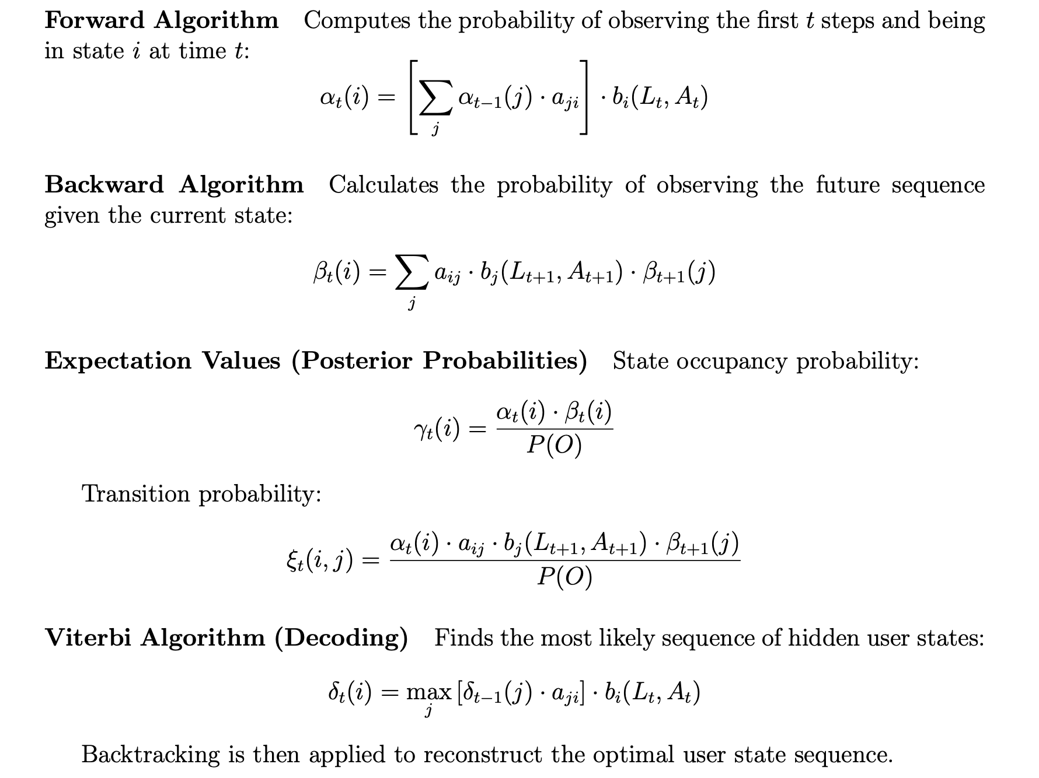

Slide 17
DYnamic Bayesian Network (DBN)
🧠 Motivation
HMM predicts sequence based on (activity, location) only.
Human behavior is influenced by external context (e.g., people eat mostly at evening, sleep at night).
DBN allows us to learn and reason with contextual correlations.
A temporal probabilistic model that extends HMM.
Models multiple variables and dependencies over time.
Suitable for incorporating contextual factors like time and temperature.
Notes:
“While HMMs were effective at capturing the sequence of user actions, they had a major limitation—they only considered activity and location.
But human behavior is often shaped by external context—things like:
Time of day: for instance, people tend to eat in the evening and sleep at night.
Temperature: extreme temperatures may influence whether a user decides to rest or stay active.
This is where Dynamic Bayesian Networks, or DBNs, come into play.
Unlike HMMs, DBNs can model the joint probability of multiple variables—allowing us to bring in these contextual features.
So in the enhanced architecture:
The HMM first predicts the top-k most likely (activity@location) combinations.
These predictions are passed into the DBN, which evaluates them in context—using time of day and temperature—to generate a refined, more accurate prediction.
The DBN serves as a contextual filter—it weighs the HMM’s predictions based on real-world behavior patterns, which greatly improves overall performance and personalization.”

Slide 18

DBN Learning Objective
Learn joint probability:
P(Activity at t,Location at t, Time at t, Tempurature at t)
From historical data using Expectation-Maximization (EM).
Final Prediction Formula
Given:
HMM predicts top-k most likely activity@location pairs:
P( Activity@Location at t | Activity@Location at t-1 )
Refined by:
DBN’s learned contextual joint probability:
Final Score = P(HMM) * P(Activity at t,Location at t, Time at t, Tempurature at t)
Selects the contextually most probable next move.
Notes:
“The goal of the Dynamic Bayesian Network in this project is to learn and reason over the joint probability of key variables that influence human behavior.
Specifically, we want to model:
P(Activity at t, Location at t, Time at t, Temperature at t)
To do this, the DBN is trained using the Expectation-Maximization (EM) algorithm on historical sensor data.
Now here’s how prediction works:
First, the HMM predicts the top-k most probable activity@location pairs for the next time step, based solely on past sequences.
Then, the DBN steps in and applies its learned joint distribution—factoring in time of day and temperature.
The final score for each prediction is computed as:
P(HMM Prediction) × P(DBN Contextual Probability)
This hybrid approach enables us to pick the most contextually relevant prediction—not just the most likely based on past behavior, but also the one that best fits the current time and environment.”

Slide 19
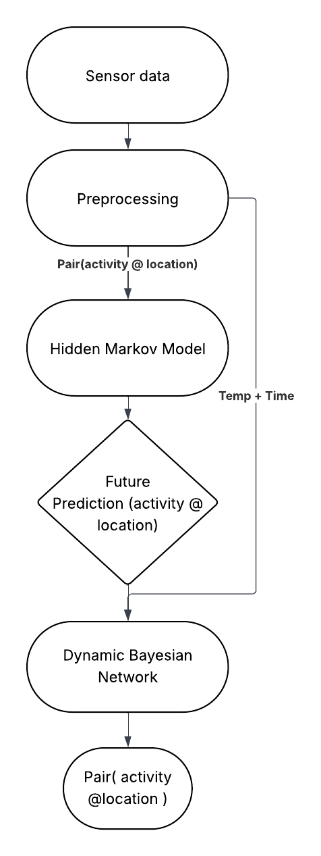
System Architecture
The system is structured to convert raw sensor signals into real-time behavior predictions using a two-stage probabilistic pipeline.
🧱 Key Components
Sensor Data Acquisition
Smart home sensors log activity, location, temperature, and timestamps.
Preprocessing
Data cleaning and structuring into sequences:
(Activity, Location, Time, Temperature)
Contextual feature engineering.
HMM Modeling
Learns behavioral transitions over time.
Predicts top-3 next (Activity, Location) pairs.
DBN Refinement
Contextual scoring of HMM predictions:
P(A_t, L_t, T_t, Temp_t)
Selects most context-aware move.
Smart Home Integration (Future Work)
Automates HVAC, lighting, appliances, and security.
Notes:
“This slide outlines the overall architecture of the predictive system—from raw sensor input to final behavior prediction.
Let’s walk through the key components:
Sensor Data Acquisition
Smart home sensors continuously log data, including user activities, their location, ambient temperature, and timestamps.
Preprocessing
The raw data is cleaned, synchronized, and structured into sequences.
Contextual features like time of day and temperature are also engineered and quantized for compatibility with probabilistic models.
HMM Modeling
The first stage in the pipeline.
It learns patterns in user behavior over time and predicts the top-3 next activity-location pairs.
DBN Refinement
The second stage that brings in contextual awareness.
It scores the HMM’s predictions using a joint probability over activity, location, time, and temperature.
The highest-scoring combination becomes the final prediction.
Smart Home Integration (Future Work)
This prediction could be used to automate actions—like turning on appliances, adjusting lights, or controlling HVAC systems—without the need for manual input.
So essentially, this architecture combines sequential modeling and contextual reasoning into a powerful and scalable solution for intelligent smart homes.”

Slide 20
Workflow
Step-by-Step Process
Data Collection
Sensor stream: activity, location, time, temperature.
Preprocessing
Clean → Quantize → Sequence.
Model Training
HMM trained with Baum-Welch on sequences.
DBN trained with EM on contextual variables.
Inference & Prediction
HMM: Viterbi decoding for top-k state transitions.
DBN: Particle Filtering for context-aware refinement.
Result
→ Predictive automation: the right action at the right time in the right room.
Notes:
“This slide illustrates the end-to-end workflow of the system—showing how each component interacts to produce a context-aware behavior prediction.
Here’s how it flows:
Sensor Input
Raw sensor data is continuously collected from the smart home environment. This includes activity logs, location info, temperature readings, and timestamps.
Data Preprocessing
The raw inputs are cleaned and formatted into structured sequences.
We also engineer contextual features like time-of-day labels and quantized temperature categories.
HMM Prediction
The preprocessed sequences are fed into the HMM.
The model analyzes the temporal patterns and predicts the top-3 likely (Activity, Location) combinations for the next step.
DBN Contextual Refinement
These predictions are then passed to the DBN, which incorporates external context—like time and temperature—to refine the results.
It outputs the most contextually probable next user state.
Final Output
The system selects the highest-ranked prediction, which can be directly used to trigger smart home actions—like turning on the light or preheating the oven.
This workflow ensures that decisions are not just based on habits but also on current environmental and temporal context.”

Slide 21
Evaluation Strategy
Observation Accuracy | Accuracy of (Activity, Location) predictions
Sequence Accuracy | Entire predicted sequence matches the actual sequence
Contextual Consistency | Predictions align with time and temperature context
Notes:
“To assess the performance of this two-stage prediction system, I used a combination of accuracy metrics and qualitative analysis.
Initially, I evaluated the HMM alone—measuring how often it could correctly predict the user’s next activity-location pair. Unfortunately, the results were not very promising, with accuracy below 10%. This highlighted the need for contextual refinement.
Next, I introduced the DBN refinement layer and re-evaluated the system.
The evaluation strategy focused on:
Comparing predictions against ground-truth observations in the dataset,
Measuring how the top-1 prediction aligned with the user’s actual next state,
And analyzing how contextual variables improved or altered the ranking of predictions.
Though the setup was relatively simple, the performance improvement from adding contextual awareness was clear—leading to substantial gains in predictive accuracy and relevance.”

Slide 22
Observations
HMM-only failed in time-sensitive or ambiguous activity cases.
1
DBN refinement corrected contextual mismatches (e.g., sleeping at night vs. resting in day).
2
Sequence-level stability increased, enhancing system usability for automation.
3
Notes:
“Here are some key observations I made during the development and evaluation of the system:
Activity-Location Alone Is Not Enough
Initially, using only activity and location data yielded poor results.
Human behavior is complex, and context plays a crucial role—time of day and environmental factors significantly influence decisions.
Contextual Variables Add Meaningful Signal
Incorporating temperature and time improved prediction relevance.
For example, the same activity—like walking—can imply different intentions based on whether it’s morning or evening.
Sequential Modeling Works, But Needs Refinement
HMMs are great at capturing behavior patterns over time.
However, they assume a Markovian structure, which means only the immediate past is considered. That’s why layering with a DBN helps bring a broader perspective.
Interpretability Is a Strength
One big advantage of using HMMs and DBNs is that the decision-making process is transparent and explainable.
You can trace how a prediction was made and why one state was chosen over another.
Overall, these observations shaped the final system design and confirmed the value of combining sequential learning with contextual reasoning.”

Slide 23
KEY Challenges
Problem | Description
Data Sparsity | Rare transitions poorly represented in training data
Overfitting | Limited data led to poor generalization
Temporal Misalignment | Same activity at different times reduced temporal signal quality
Sensor Noise | Irregular or meaningless activations polluted sequences
Notes:
“Every project has its share of challenges, and this one was no exception. Here are some of the main hurdles I encountered:
Sparse and Noisy Data
Sensor data from smart homes can be inconsistent—some activities are underrepresented, and sometimes sensors don’t trigger correctly.
Cleaning and aligning this data while preserving temporal relationships was a major task.
Ambiguity in Observations
The same observation—like ‘walking in hallway’—could represent multiple internal states: active, anxious, or transitioning between activities.
It’s hard to infer intent from behavior without additional context.
Context Quantization
Time and temperature are continuous variables, but probabilistic models like DBNs work better with discrete states.
I had to carefully quantize these variables—like converting time into morning, afternoon, evening—and ensure that this simplification didn’t degrade prediction quality.
Model Integration
Blending HMM outputs into DBN inputs required careful handling—especially in terms of how probabilities were passed and normalized between stages.
Each of these challenges required design decisions, experimentation, and iterative refinement to overcome and build a robust system.”

Slide 24
Solutions Implemented
Solution | Applied Technique
Smoothing | Laplace smoothing + synthetic data generation for low-frequency paths
Regularization | Model tuning using AIC/BIC to reduce complexity
Time Quantization | Time binned into: Morning, Afternoon, Evening, Night
Data Cleaning | Filters to eliminate sensor flickers & enforce sequence continuity
Notes:
“To tackle the challenges I just described, I implemented a number of targeted solutions:
Data Preprocessing Pipeline
I developed a structured pipeline to clean and merge the CASAS datasets.
This included aligning timestamps, filtering noisy sensor events, and engineering contextual features like time segments and temperature categories.
Feature Engineering with Context
Time of day was discretized into intervals like Morning, Afternoon, Evening, and Night.
Temperature was similarly binned to create interpretable categories like Cold, Moderate, and Hot—helping the DBN process them effectively.
Two-Stage Modeling
I designed a hybrid system where the HMM models user behavior over time, and the DBN layers in context for smarter decision-making.
This modular design also allows for flexibility—future context variables like presence of others or day of the week can be added.
Probability-Based Ranking
I used a scoring formula that multiplies the HMM and DBN probabilities.
This ranking system made it easy to select the most contextually appropriate prediction rather than just the statistically most frequent one.
These solutions helped improve accuracy, stability, and the overall interpretability of the system—making it both functional and scalable.”

Slide 25
Future Work
Real-Time Smart Home Integration
Deploy prediction engine in live smart home setups.
Automate:
🔒 Door locks
☕ Coffee machines
💡 Lighting & HVAC
Evaluate: Latency, stability, and user experience
🔍 Enhanced Context Modeling
Add richer contextual inputs to DBN:
Humidity, ambient light
Calendar/events
External conditions (e.g., weather)
Improve recognition of subtle behaviors
📊 Diverse & Scalable Data
Incorporate multi-user datasets
Support various:
Household types
Cultural routines
Home layouts
📈 Optimization & Tuning
Use:
Bayesian optimization
Model pruning
Real-time scheduling
Improve performance and scalability
👥 Multi-User Modeling
Distinguish behavior for multiple occupants
Track individuals independently for personalized automation
Notes:
“Looking ahead, I plan to extend this system in a few key ways:
Enable real-time predictions with live sensor input.
Support multi-resident modeling to handle shared spaces.
Add more contextual factors like day of the week or calendar events.
Integrate with actual smart home devices for automation.
These steps will bring the system closer to being a truly intelligent, context-aware assistant.”

Slide 26

Conclusion
✅ Project Highlights
Designed a hybrid HMM + DBN model for predicting user behavior in smart homes.
Learned from:
Activity & location sequences
Contextual features like time and temperature
🔍 Key Results
HMM alone: very low accuracy
HMM + DBN: high accuracy
Improved contextual relevance and sequence stability
🧠 Core Contributions
End-to-end modeling pipeline: Sensor data → Predictions → Smart automation
Real-time, interpretable, and generalizable framework
🎯 Towards a future where smart homes are predictive, adaptive, and intelligently aware of user needs.
Notes:
“To summarize:
I built a hybrid prediction system using HMMs and DBNs to model and anticipate user behavior in smart homes.
The HMM captures sequential patterns, while the DBN adds contextual intelligence using time and temperature.
This combination led to significant improvements in prediction accuracy compared to using HMM alone.
The system is interpretable, scalable, and forms a strong foundation for future real-time smart automation.
Thank you for your time—I’m happy to take any questions.”

Slide 27
Thank you

